Slide 1

ChIP-Seq Analysis
Simon Andrews
simon.andrews@babraham.ac.uk
@simon_andrews
v2022-02

Slide 2
What this course covers
The theory of ChIP-Seq
ChIP-Seq library properties
Sequencing, Data processing and QC
Data visualisation and exploration
Types of analysis
Peak Calling
Differential Binding

Slide 3
What is ChIP-Seq?
ChIP-Seq is a technology which uses high-throughput sequencing to infer the positions of any mark associated with DNA which can be captured by an antibody.

Slide 4
Types of antibody
Transcription factors / repressors
nanog, CTCF
Histones and histone modifications
H3, H3K4me3
DNA modifications
Methyl-Cytosine, Formyl cytosine
Chromatin remodelling proteins
BMI1, EZH2
Transcription machinery
Pol2

Slide 5
How Does ChIP-Seq work
DNA
Cross-link proteins to DNA
DNA
Fragment DNA (sonication, MNase etc)
Capture
Y
Y
Y
Y
Y
Y
Y
Y
Elute
Remove Crosslinks
Size Select
Add Adapters
Sequence

Slide 6
Related Techniques
ATAC-Seq
Uses transposases to digest exposed DNA to enrich for accessible DNA.
Cut and Run
Uses transposes fused to antibodies to find marked, accessible chromatin
DamID/DamIP
Fuses a methyltransferase to a protein then measures methyl-Adenine by bisulphite seq (DamID) or mA ChIP (DamIP)

Slide 7
What can you sequence?
Y
Y
Y
Y
Y
Y
Y
Y
Y
Y
Y
Y
Y
Y
Y
Y
ChIP Material
Mock (IgG)ChIP Material
Input Material (sonicated / Mnase / H3 etc)

Slide 8
Sequencing for ChIP
Barcode
Adapter
ChIP Fragment
Adapter
Barcode
Read 1
Primer
Adapter
ChIP Fragment
Read 2
Primer
ChIP Fragment
Adapter
Barcode Read

Slide 9
What you end up with

Slide 10
Single End vs Paired End
Insert
Paired
(= >$£€¥)
Read 1
Read 2
Inferred
Read 1
Single
(= Cheaper!)
Inferred

Slide 11
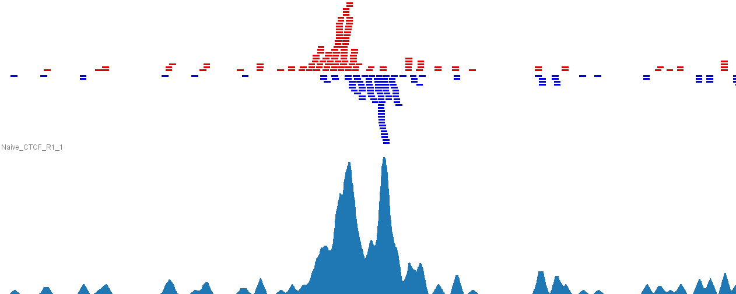
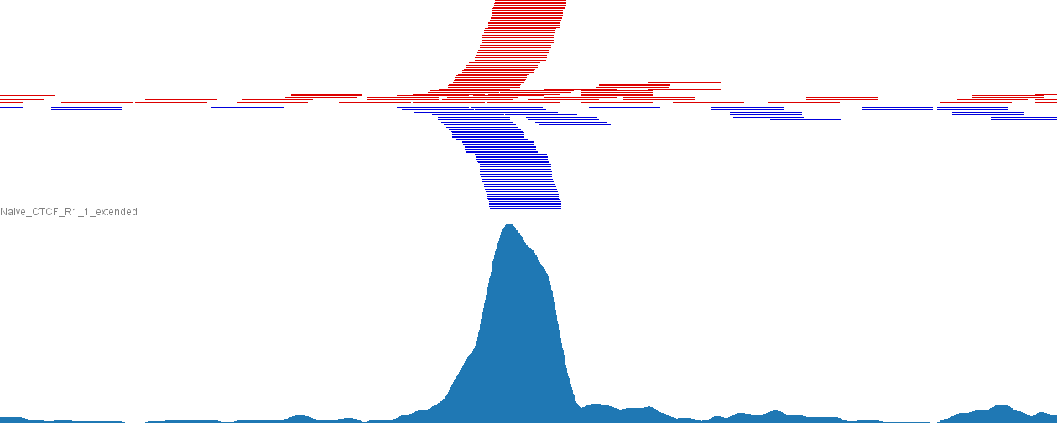
What you end up with
Original
40bp
Reads
Extended
by
250bp

Slide 12
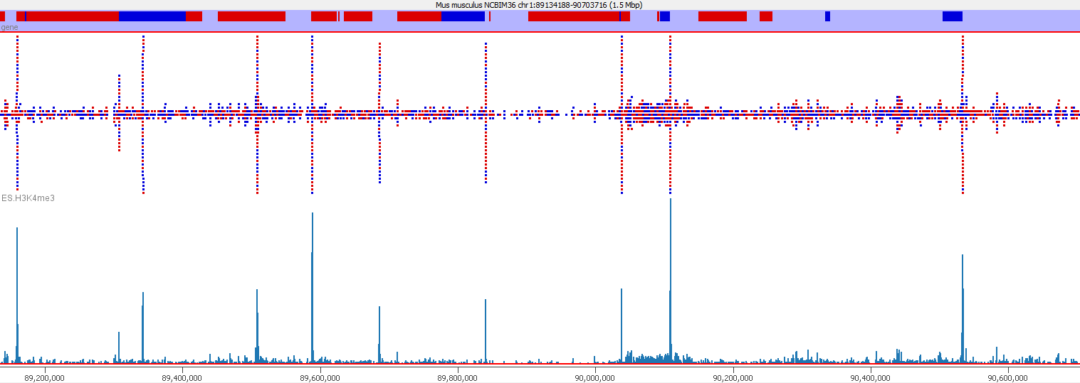
Types of Enrichment
Single points (typical TF, some histone marks)

Slide 13
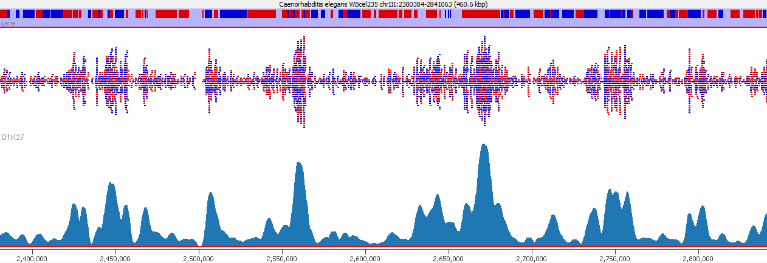
Types of Enrichment
Broad Regions (some histone marks, PolII)

Slide 14
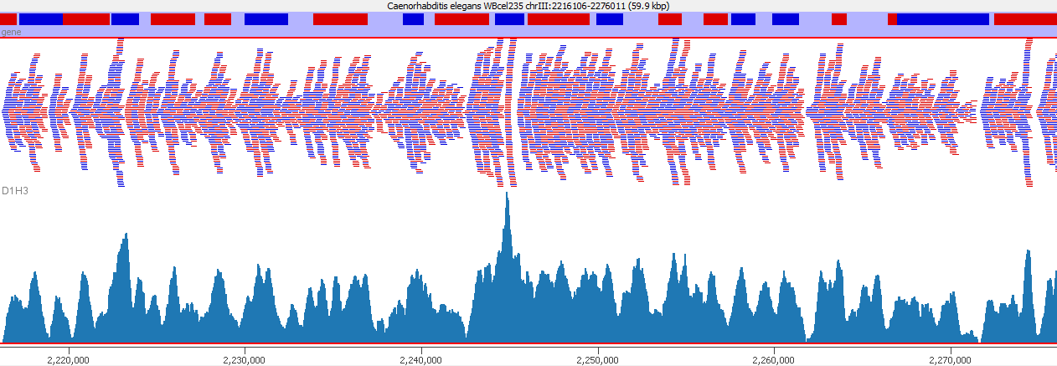
Types of Enrichment
Virtually everywhere (h3)

Slide 15
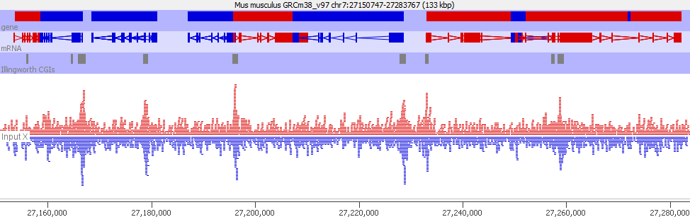
Types of Enrichment
Artefactual (GC in this case)

Slide 16
What are you actually measuring?
ChIP Seq measures RELATIVE enrichment
Region A has twice as much signal as Region B
Without some external calibration, NOTHING in ChIP-Seq gives an ABSOLUTE measure.

Slide 17

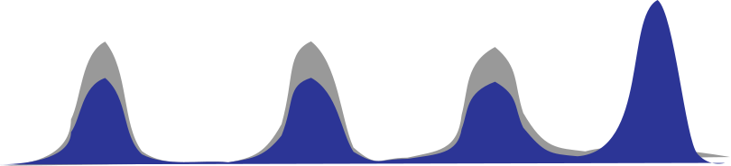

What can affect enrichment?
Starting
More Sites
Poorer Signal

Slide 18
What sort of questions can you answer?
Where is this mark present?
General - it's in promoters, gene bodies etc.
Specific - it's at these loci
How does this mark change when I do XXX?
Categorical: A peak disappears
Quantitative: The enrichment of a locus changes

Slide 19
ChIP-Seq Data Processing and QC

Slide 20
A typical ChIP Library
Barcode
Adapter
ChIP Fragment
Adapter
Barcode
Potential technical problems
Adapter contamination
PCR Duplication
Potential biological problems
Lack of enrichment
Other selection biases

Slide 21
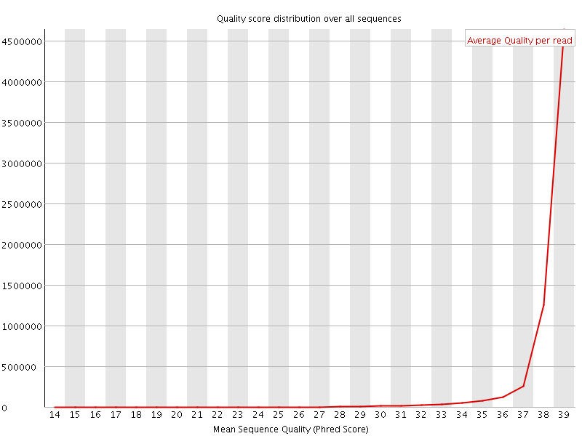

QC of raw sequence Base Call Quality

Slide 22
QC of raw sequence Sequence Composition

Slide 23
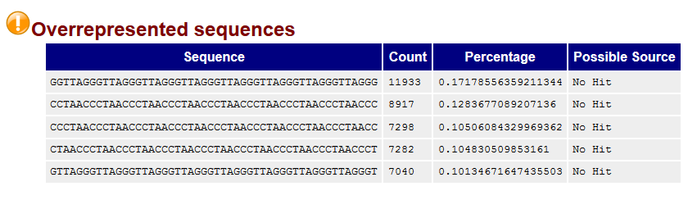
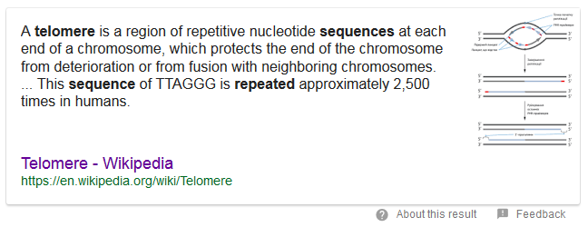
QC of raw sequence Sequence Composition

Slide 24
QC of raw sequence Adapter Contamination
Barcode
Adapter
ChIP Fragment
Adapter
Barcode
Read
Trim Galore!
Quality and Adapter Trimming

Slide 25
Mapping ChIP Data
All regions should be linear genomic stretches
Standard genomic aligners are fine
Bowtie2 http://bowtie-bio.sourceforge.net/bowtie2/
BWA http://bio-bwa.sourceforge.net/

Slide 26
Example Bowtie2 Mapping
Create Genome Index (once - slow!)
Map a single FastQ file
bowtie2-build yeast_genome.fa yeast_index
bowtie2 \
-x yeast_index \
-U data.fastq.gz \
| samtools view \
-bS \
-o data.bam

Slide 27
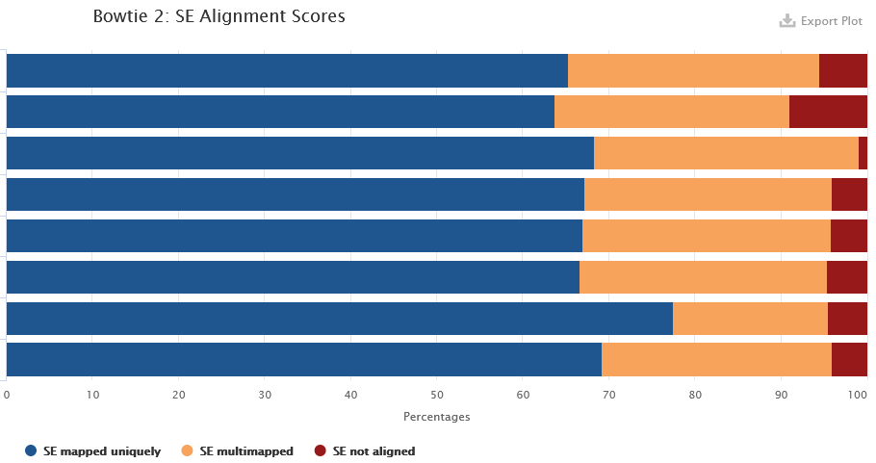

Post Alignment QC Mapping Statistics
41523294 reads; of these:
41523294 (100.00%) were unpaired; of these:
1851792 (4.46%) aligned 0 times
32175322 (77.49%) aligned exactly 1 time
7496180 (18.05%) aligned >1 times
95.54% overall alignment rate

Slide 28
Post Alignment Processing MAPQ Filtering
ChIP-Seq relates sequences to positions in a reference genome
You need to be confident that the reported position is correct
Filtering on MAPQ value (likelihood of reported position being incorrect) is an easy way to do this
MAPQ filtering should be performed in most cases
samtools view -q 20 -b -o filtered.bam data.bam

Slide 29
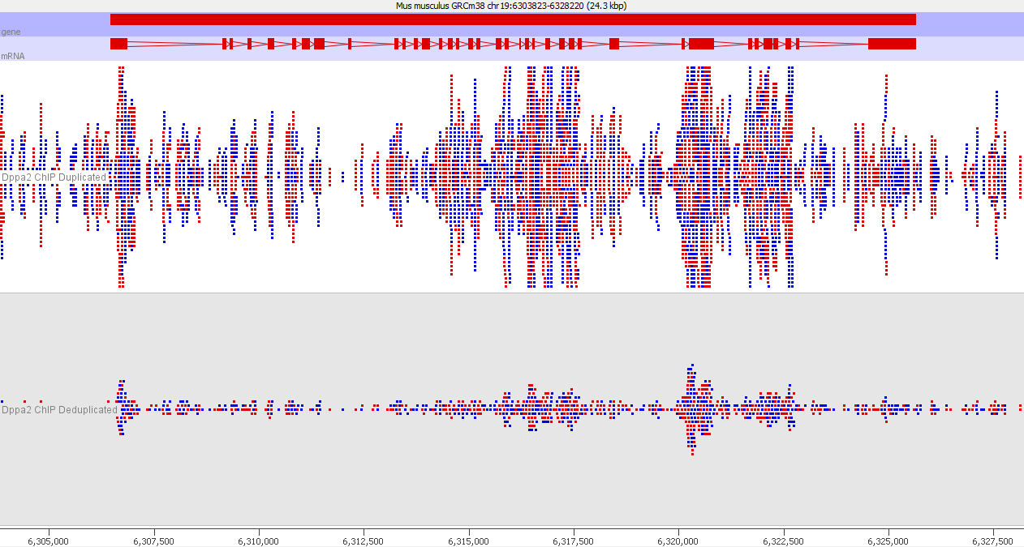
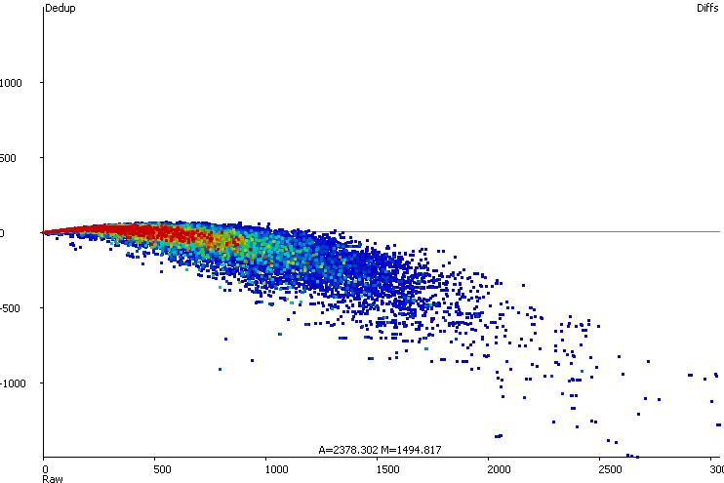
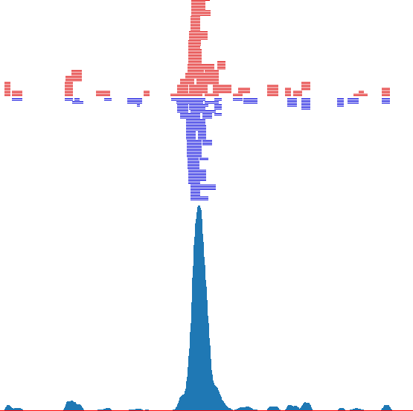
To Deduplicate or Not?
Deduplication can make enrichment visually clearer and help to spot truly enriched regions
Deduplication alters quantitation

Slide 30
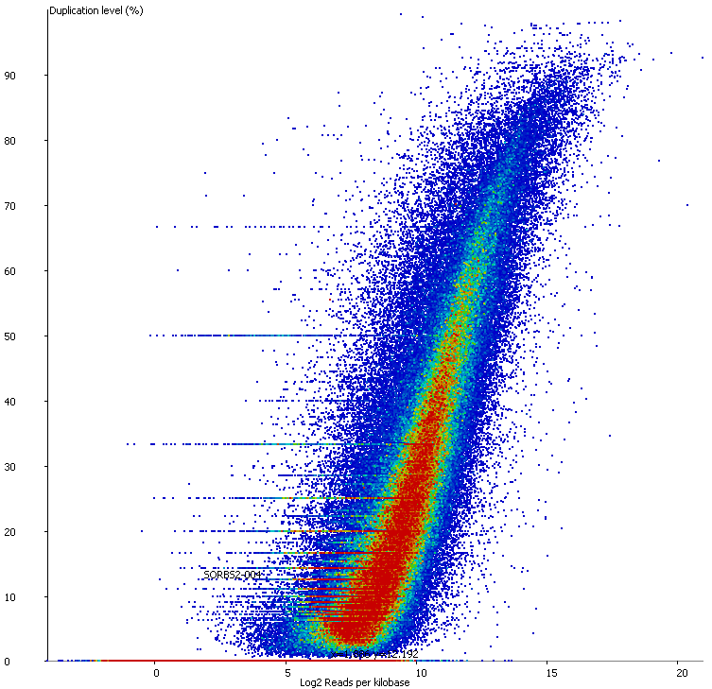
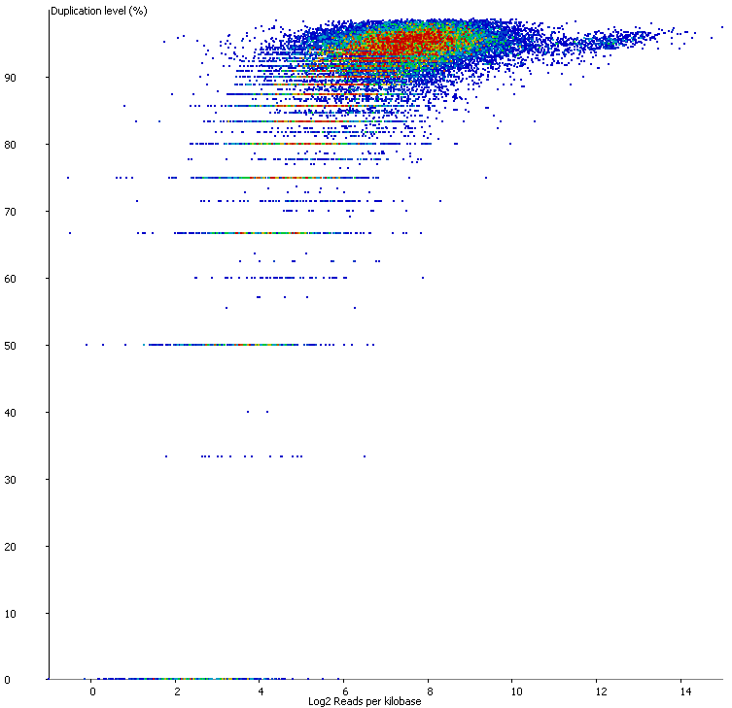
Assessing Duplication
Observed Duplication (%)
Observed Duplication (%)
Read Density
Read Density

Slide 31
Performing Deduplication
java -jar picard.jar SortSam \
INPUT=filtered.bam \
OUTPUT=sorted.bam \
SORT_ORDER=coordinate
java -jar picard.jar MarkDuplicates \
INPUT=sorted.bam \
OUTPUT=dedup.bam \
METRICS_FILE=metrics.txt
Only deduplicate if
You can see that you have technical duplication in your data
You only care about identifying enriched regions (peaks)
You don’t need quantitative enrichment values for your peaks
DO NOT DEDUPLICATE AS A MATTER OF COURSE! THINK FIRST!

Slide 32
Standard Processing Workflow
Mapping Stats
Mapping Stats
Mapping Stats
Trim
Galore
SAM
Tools
FastQ File
Trimmed FQ File
BAM File
Filtered BAM
FastQ File
Trimmed FQ File
Bowtie
BWA
BAM File
Filtered BAM
FastQ File
Trimmed FQ File
BAM File
Filtered BAM
FastQC
FastQC
FastQC Report
FastQC Report
MultiQC Report
Visualisation and Assessment
FastQC Report
FastQC Report
FastQC Report
FastQC Report

Slide 33
Running programs in Linux
Open a shell (text based OS interface)
Type the name of the program you want to run
Add on any options the program needs
Press return - the program will run
When the program ends control will return to the shell
Run the next program!

Slide 34
Running programs
babraham@babraham-VirtualBox:~$ ls
Desktop Documents Downloads examples.desktop Music Pictures Public Templates Videos
babraham@babraham-VirtualBox:~$
Command prompt - you can't enter a command unless you can see this
The command we're going to run (ls in this case, to list files)
The output of the command - just text in this case

Slide 35
The structure of a unix command
ls -ltd --reverse Downloads/ Desktop/ Documents/
Program
name
Switches
Data
(normally files)
Each option or section is separated by spaces. Options or files with spaces in must be put in quotes.

Slide 36
Command line switches
Change the behaviour of the program
Come in two flavours (each option usually has both types available)
Minus plus single letter (eg -x -c -z)
Can be combined (eg -xcz)
Two minuses plus a word (eg --extract --gzip)
Can't be combined
Some take an additional value, this can be an additional option, or use an = to separate (it's up to the program)
-f somfile.txt (specify a filename)
--width=30 (specify a value)

Slide 37
Specifying file paths
Absolute or Relative paths from whichever directory you are currently in
/home/simon/Documents/Data/big_data.fq.gz
Move to the directory with the data and just use file names
cd Data
big_data.fq.gz

Slide 38
Command line completion
Most errors in commands are typing errors in either program names or file paths
Shells (ie BASH) can help with this by offering to complete path names for you
Command line completion is achieved by typing a partial path and then pressing the TAB key (to the left of Q)

Slide 39
Command line completion
Actual files in a folder:
Desktop
Documents
Downloads
examples.desktop
Music
Pictures
Public
Templates
Videos
If I type the following and press tab:
De [TAB] will complete to Desktop as it is the only option
T [TAB] will complete to Templates as it is the only option
Do [TAB] will no nothing (just beep) as it is ambiguous
Do [TAB] [TAB] will show Documents and Downloads since
those are the only options
Do [TAB] [TAB] c [TAB] will complete to Documents
You should ALWAYS use TAB completion to fill in paths for
locations which exist so you can't make typing mistakes
(it obviously won't work for output files though)

Slide 40
Debugging Tips
If anything (except the splice site extraction) completes almost immediately then it didn't work!
Look for errors before asking for help. They will either be
The last piece of text before the program exited
The first piece of text produced after it started (followed by the help file)
To see if a program is running go to another shell and look at the last file produced to see if it's growing
Programs which are stuck can be cancelled with Control+C

Slide 41
Some useful commands
cd mydir Change directory to mydir
ls -ltrh List files in the current directory, show details and put the newest files at the bottom
less x.txt View the x.txt text file
Return = down one line
Space = down one page
q = quit

Slide 42
Data Processing Exercise

Slide 43
Exploring and Understanding ChIP-Seq data

Slide 44
Some Basic Questions
Is there any enrichment?
What is the size / patterning of enrichment?
How well are my controls behaving?
What is the best way to quantitate this data?
Are there any technical artefacts?

Slide 45
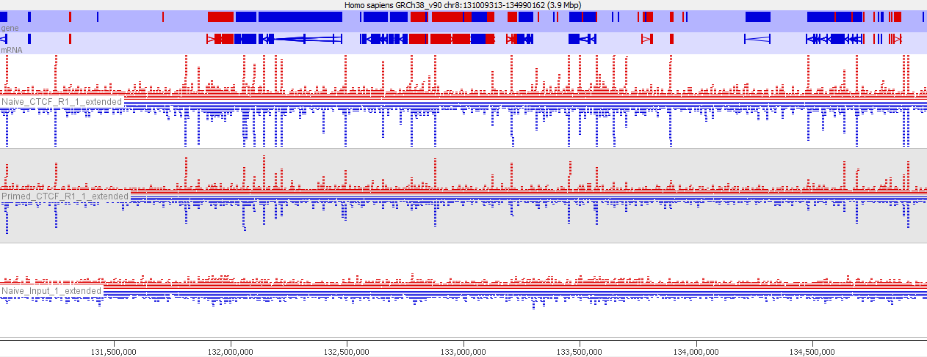
Start with a visual inspection
Is there any enrichment?
What is the size / patterning of enrichment?
How well are my controls behaving?

Slide 46
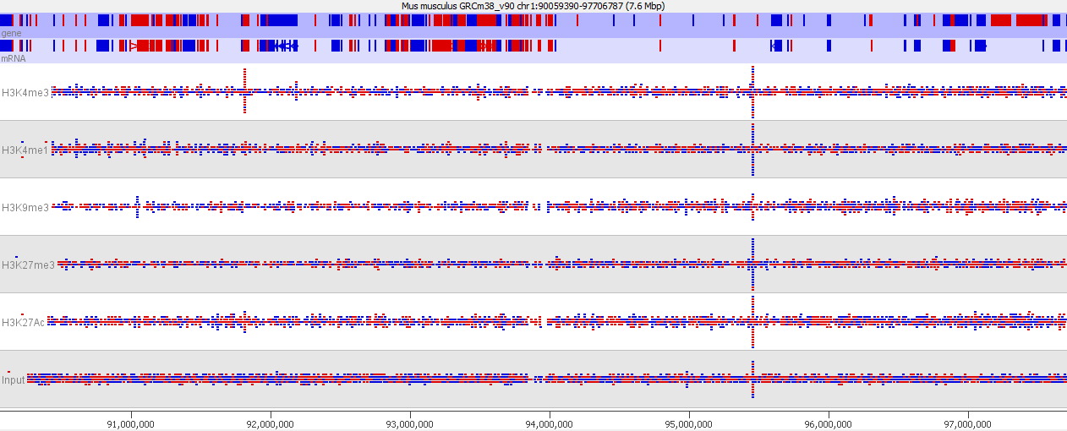
Start with a visual inspection
Is there any enrichment?
What is the size / patterning of enrichment?
How well are my controls behaving?

Slide 47
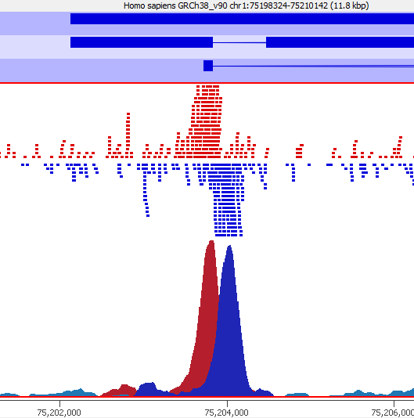
Extending reads if necessary
For point enrichment, insert size is roughly peak width/2
Peak Width

Slide 48
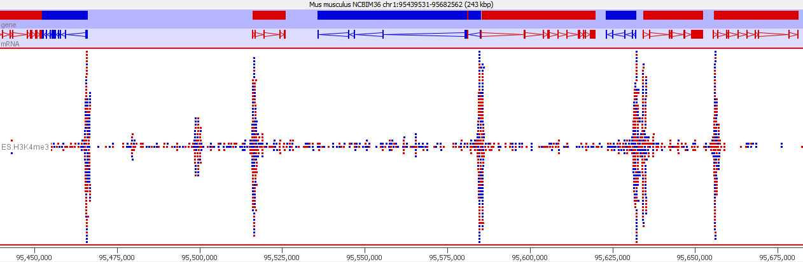
Look for peaks Associate with features
TSS
TSS
TSS
TSS
TSS
Are my peaks narrow or broad
Do peak positions obviously correspond to existing features?

Slide 49
Examine Controls
IgG or other Mock IP
Good result is no material at all
Not worth sequencing. Reads are only informative if the ChIP hasn't worked.
May be justified for Cut and Run where there is no real input
Input material (sonicated / Mnase etc)
Genomic library - everywhere equally
Technical issues can cause variation

Slide 50
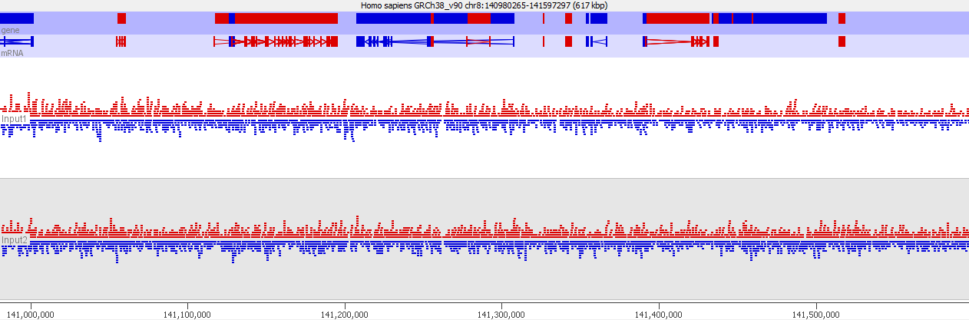
Examine Controls
Does the coverage look even
If there are multiple inputs to do they look similar

Slide 51
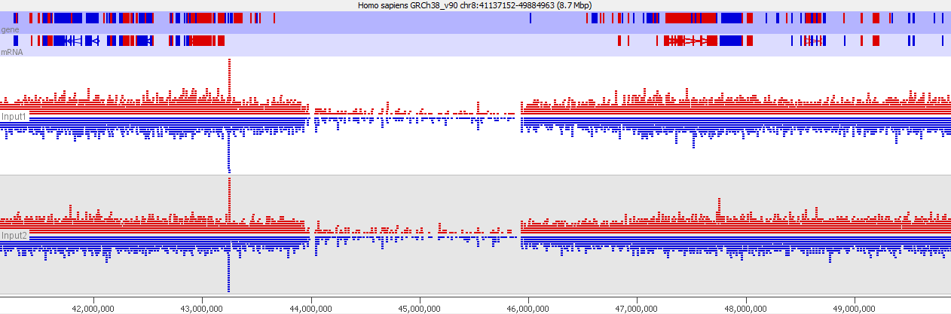
Examine Controls

Slide 52
Why do controls misbehave?
Low coverage
Repetitive unmappable regions
Holes in the assembly
High coverage
Mismapped reads from outside the assembly
Biases
GC content
Segmental Duplication
Blacklist these regions and remove them from the analysis (ignore hits within these regions)
Input normalisation might help, but requires further examination

Slide 53
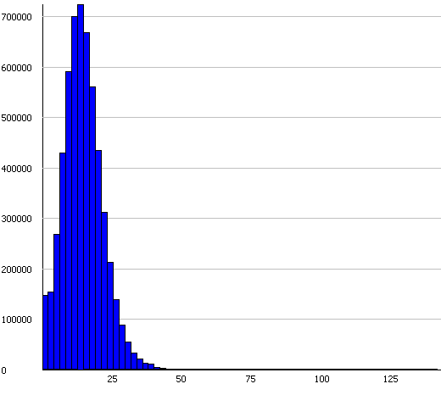
Making Blacklists
Unusual Coverage
Outlier detection (boxplots etc.)
Often only filter over-representation (maybe also zero counts)
Pre-built lists
Large projects often build these
ENCODE / ModENCODE
UCSC
Not for all species
https://sites.google.com/site/anshulkundaje/projects/blacklists

Slide 54
Comparison of samples

Slide 55
Initial Quantitation
Always start with a simple unbiased quantitation (not focussed on features/peaks)
Tiled measures over the whole genome
Use approximate insert size as window size
Something around 500bp is normally sensible
Linear read count quantitation corrected for total library size

Slide 56
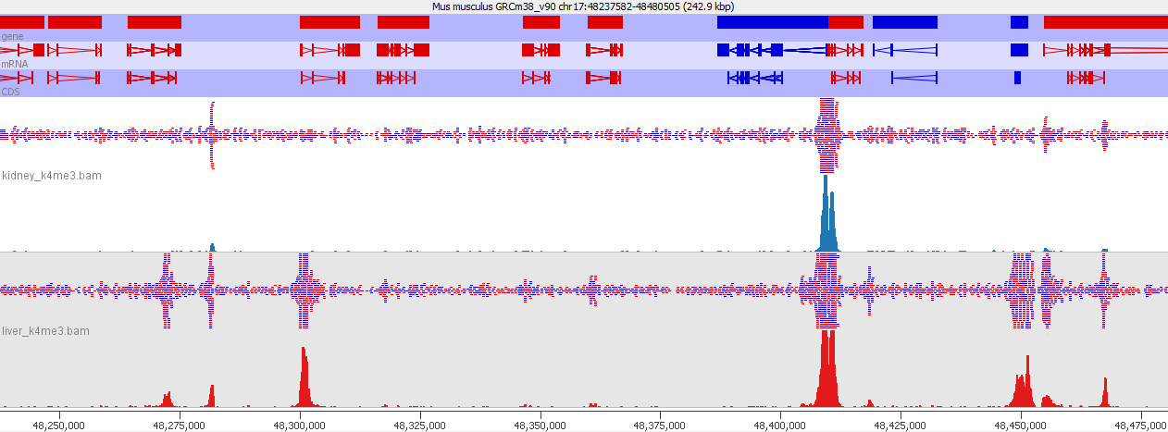
Compare samples Visual comparison against raw data
Similar apparent overall enrichment
Any obvious differences?

Slide 57
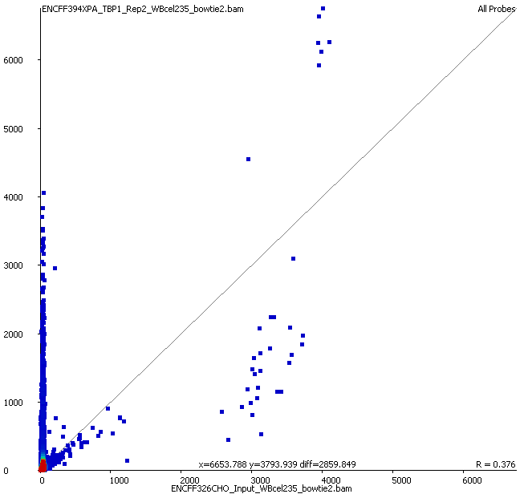
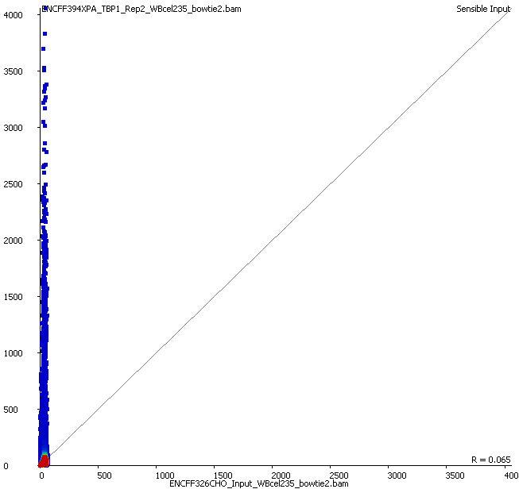
Compare samples Scatterplot input vs ChIP
Raw
Filtered

Slide 58
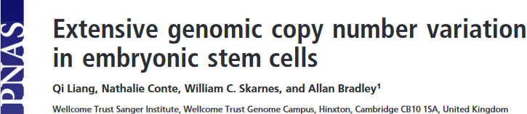
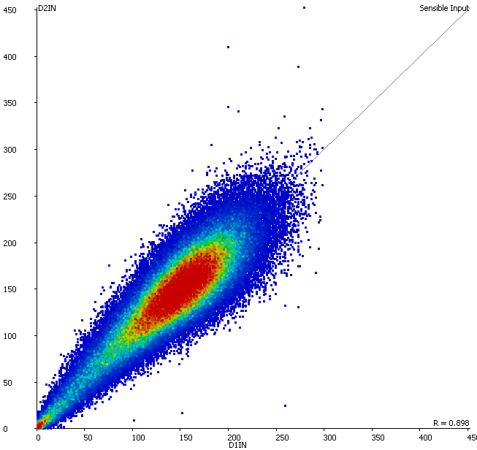

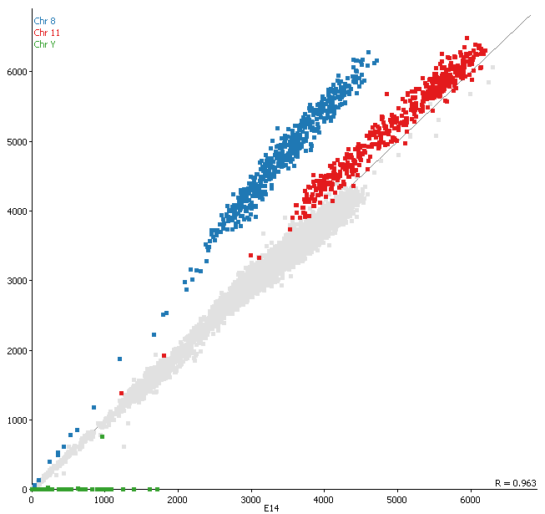
Compare samples Scatterplot input vs input
Chr 8
Chr 11
Chr Y
Any suggestion of differential biases in inputs
Can we merge them to use as a common input

Slide 59
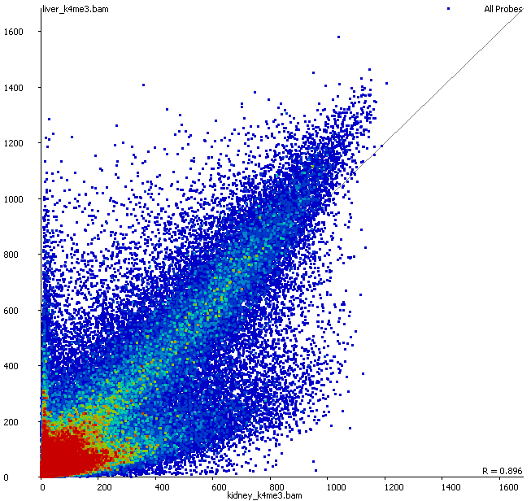
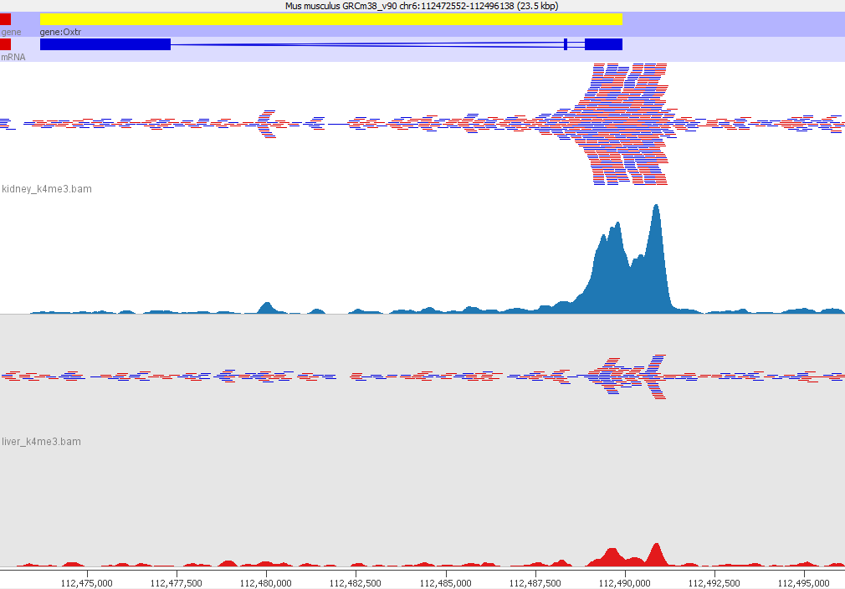
Compare samples Scatterplot ChIP vs ChIP
Look at examples for different parts of the plot
Look for outgroups (differentially enriched)
Compare level of enrichment (compare to diagonal)

Slide 60
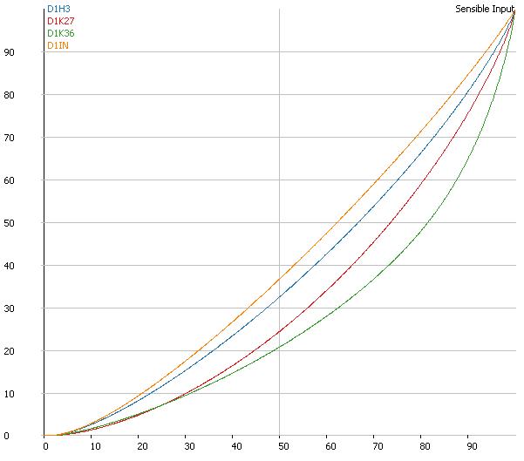
Compare samples Summarise distributions
QQPlot
Percentile though measures(x) vs Percentile through total quantitation (y)
Perfect input is on the diagonal
More enrichment moves the curve down and right
How flat is your input? How consistent are the ChIPs?

Slide 61
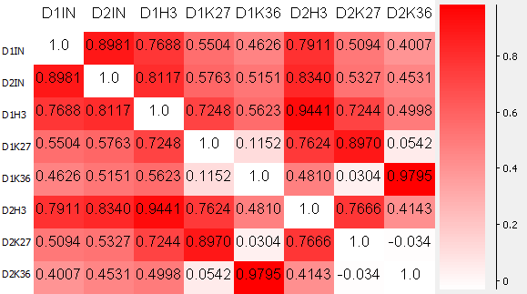
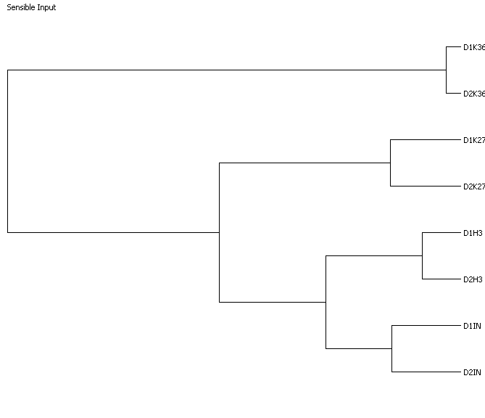
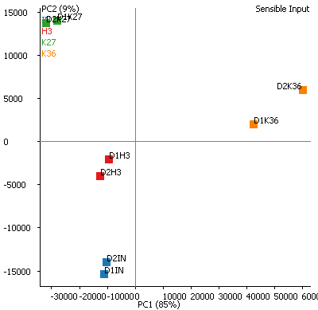
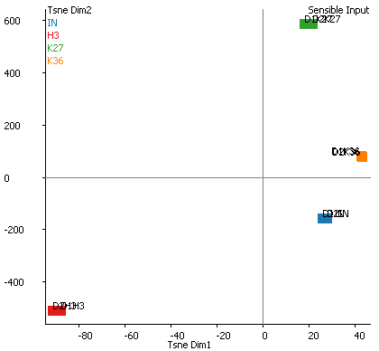
Compare samples Higher level clustering
Correlation Matrix
Correlation Tree
tSNE Plot
PCA Plot

Slide 62
Associate enrichment with features

Slide 63
Trend Plots
Graphical way to look at overall enrichment relative to positions in features
Gene bodies
Promoters
CpG islands
May influence how we later quantitate and analyse the data
Analyse per feature
Look for exceptions to the general rule

Slide 64
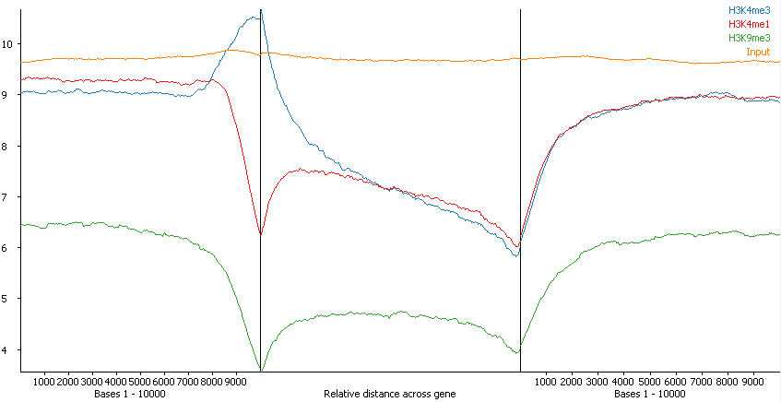
Trend Plot Example
Overall average
Says nothing about the number / proportion of features affected

Slide 65
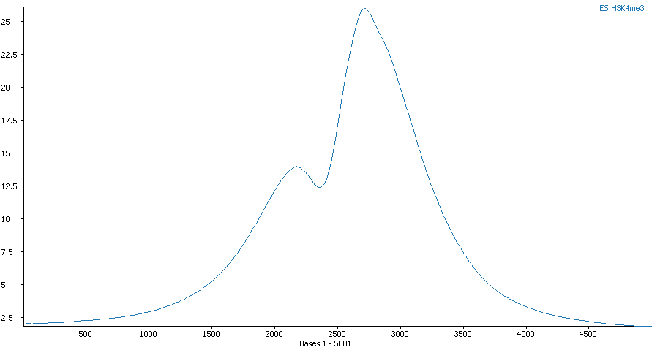
Check apparent trends against the data
TSS

Slide 66
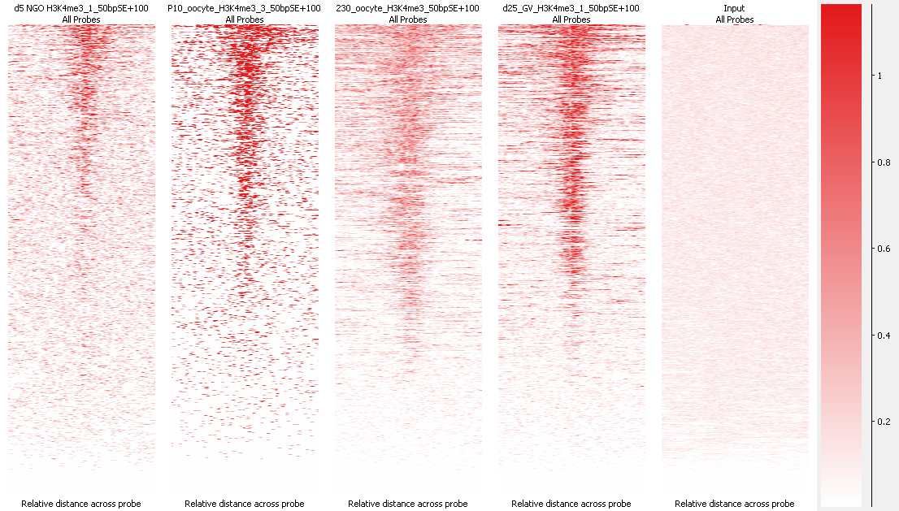
Aligned Probes Plots give more detail
Information per feature instance
Comparison of equivalent features in different marks/samples

Slide 67
After exploration you should...
Know whether your ChIP is really enriched
Know the nature / shape of the enrichment
Know whether your controls behave well
Know whether you're likely to have differential enrichment
Know if you will need additional normalisation
Know the best strategy to measure your data

Slide 68
Data Exploration Exercise

Slide 69
Analysing ChIP-Seq Data

Slide 70
Steps in Analysis
Define enriched regions
Based around features
De-novo peak prediction
Quantitate
Corrections and Normalisation
Compare
Categorical
Quantitative

Slide 71
Defining Regions - Should I peak call?
Choices
Make measurements around features (promoters / genes / CpG islands etc)
Make measurements around enriched regions (peaks)
Can I use features?
Do you see a strong and complete linkage between enrichment and the type of feature you want to use?
If not, then you should peak call

Slide 72
How MACS Works
Optimise the starting data
Build a background model
Test sliding windows
Report
Apply per-site adjustment
macs2 callpeak --broad -t chip.bam -c input.bam

Slide 73
Optimise the starting data
Correct the for/rev offset
Deduplicate

Slide 74
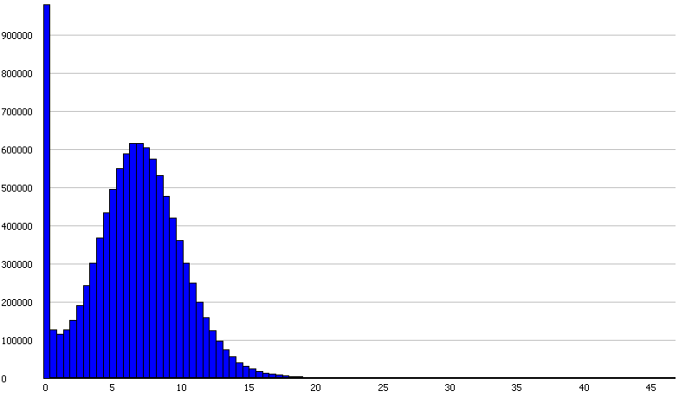
Build a background model
Lambda value
Observed

Slide 75
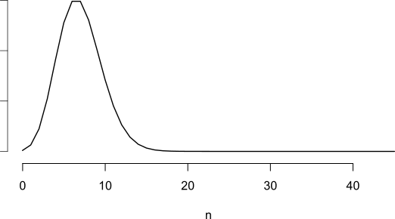
Build a background model
Lambda value
Critical p-value (n=18)
Model

Slide 76
Build a background model
Lambda value
Critical p-value (n=18)
Observed + Model

Slide 77
Test Sliding Windows
Generally use half of the library fragment size
Windows whose count exceeds the critical value are kept
Merge adjacent windows over the critical value to form peaks
Generates candidate (not final) peak set

Slide 78
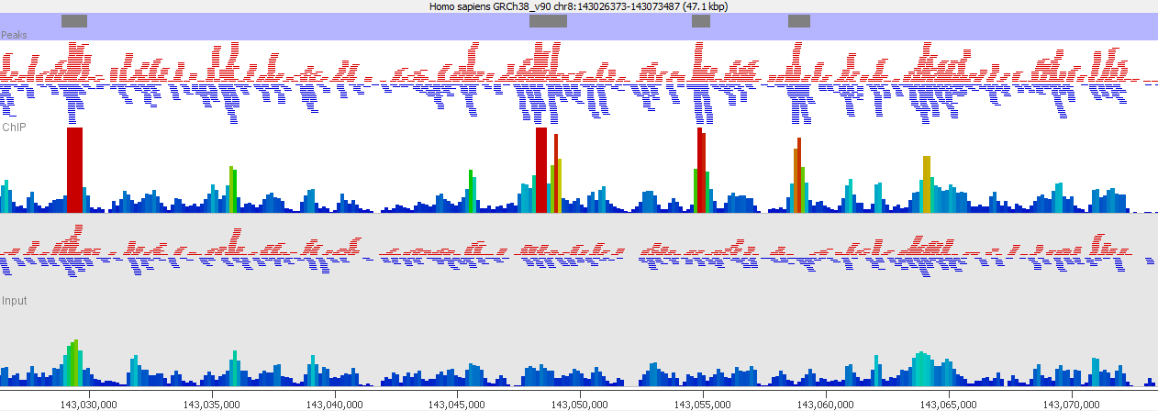
Correct for local variation
Critical value
Generate localised model if input density
is higher than the global value
Most pessimistic p-value is kept

Slide 79
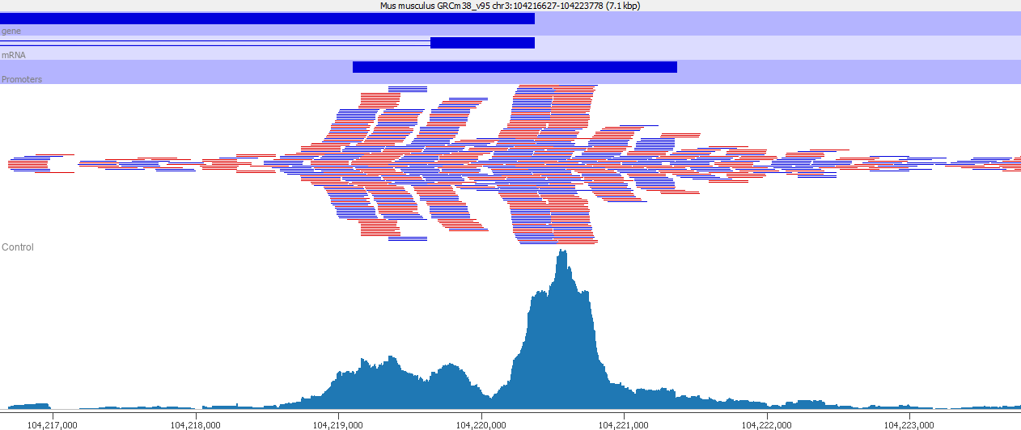
Broad Peaks
Added in MACS2 – suitable where larger regions with variable enrichment exist
Uses two thresholds for enrichment

Slide 80
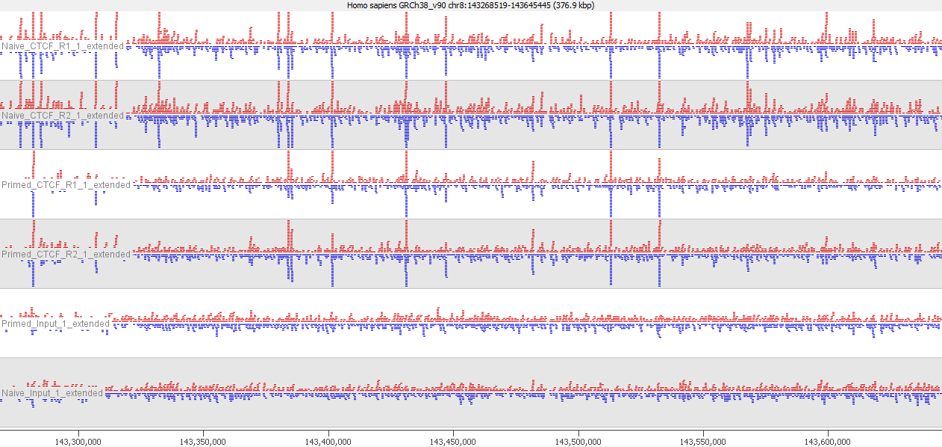
How should you apply peak callers
Multiple ChIPs (over multiple conditions)
Multiple Inputs

Slide 81
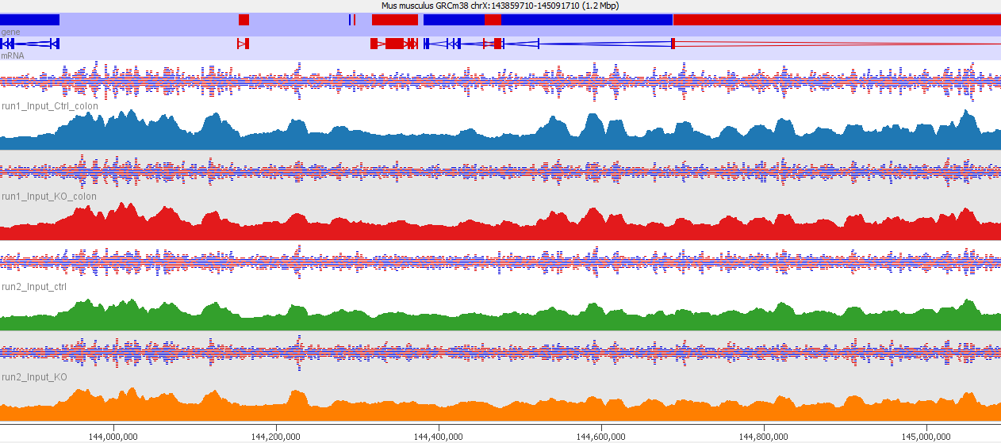
Multiple Inputs
Input variability is generally consistent
Mapability
Genome Assembly
Fragmentation biases
Unless you see substantial variability between inputs it’s better to combine them into a single reference input sample

Slide 82
Multiple ChIPs
BAM Files
Peak Sets
WT ChIP 1
WT ChIP 1
+
WT ChIP 2
+
KO ChIP 1
+
KO ChIP 2
Peaks
WT ChIP 1
+
WT ChIP 2
+
KO ChIP 1
+
KO ChIP 2
WT ChIP 2
KO ChIP 1
KO ChIP 2

Slide 83
Multiple ChIPs
BAM Files
Peak Sets
WT ChIP 1
WT Peaks 1
WT Peaks 1
And
WT Peaks 2
WT Peaks 1
And
WT Peaks 2
Or
KO Peaks 1
And
KO Peaks 2
WT ChIP 2
WT Peaks 2
KO ChIP 1
KO Peaks 1
KO Peaks 1
And
KO Peaks 2
KO ChIP 2
KO Peaks 2

Slide 84
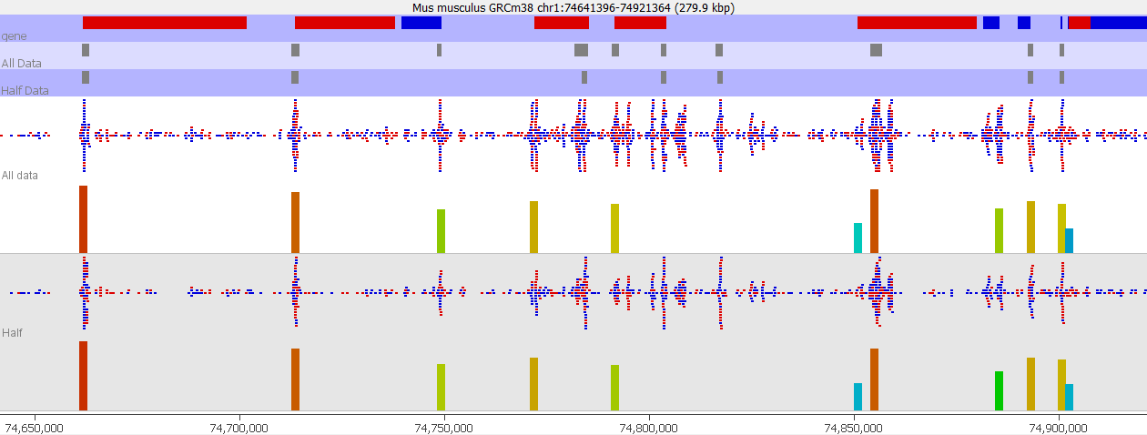
Why isn't a peak called
Fewer peaks are called by just sub-sampling the same data

Slide 85
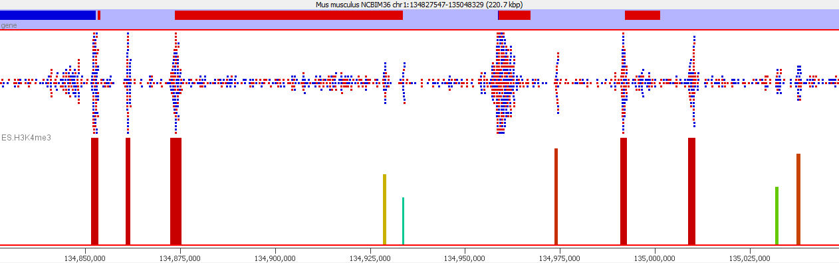
Why isn't a peak called
With no input the region around the peak is used to model the background. Broader peaks can be missed
For ATAC data (no input) you should skip the rescoring step
(--nomodel)

Slide 86
Reporting on Peak sets
Don’t make claims based solely on the number of peaks (“there were more WT peaks than KO peaks” for example)
Don’t make claims based on regions being peaks in 1 set but not another (there were 465 peaks which were specific to KO)
It is OK to make statements about overlap (there were 794 peaks which were common to WT and KO)
You have to address differential enrichment problems quantitatively

Slide 87
Quantitating ChIP data for analysis
Quantitation of ChIP is not a simple problem
Can start with something simple but in many cases you will need to refine this
Globally corrected log counts are a good place to start

Slide 88
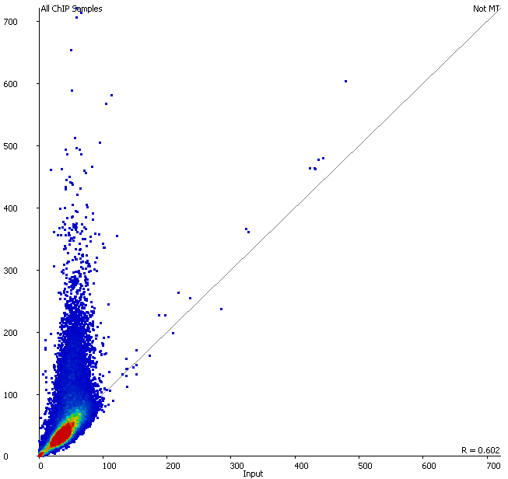
Should I normalise to input?
Only consider input normalisation if:
You have substantial variation in the coverage of your input (excluding outliers)
Your ChIP signal is correlated with the input level

Slide 89
Why not just always do "fold over input"?
Region | Input | ChIP | ChIP/Input
Region A | 5 | 200 | 40
Region B | 2 | 200 | 100
Inputs are generally poorly measured
Poor coverage compared to ChIP
Fold change values are more influenced by input than ChIP
Biases in the input are smaller than enrichment power of the antibody

Slide 90
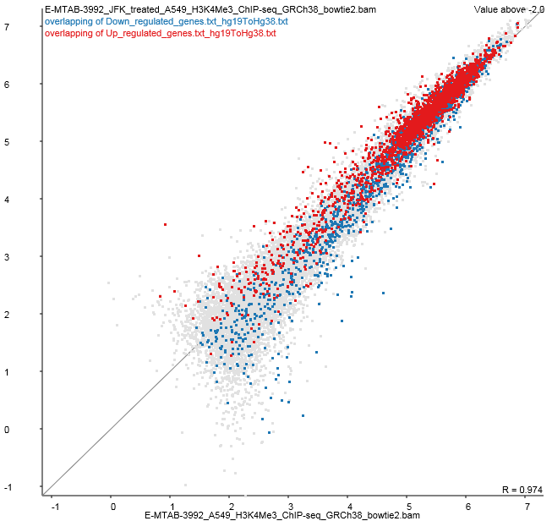
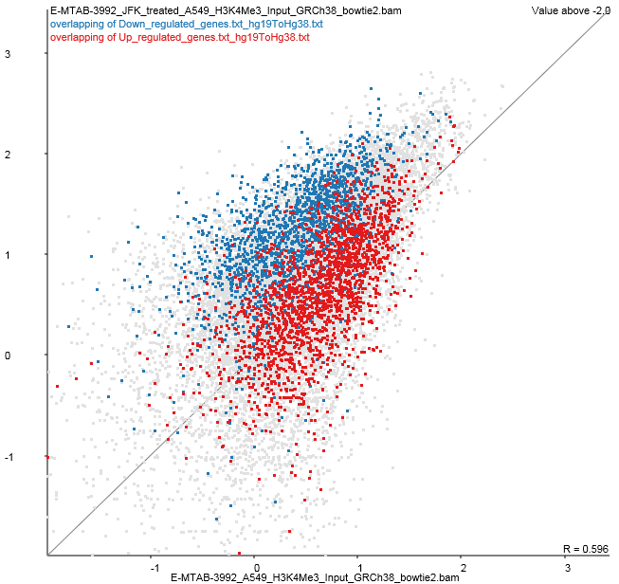
Hits with increased enrichment
Hits with decreased enrichment

Slide 91
Evaluating and Normalising Enrichment
Good Enrichment
Worse Enrichment
Similar Enrichment
Small Difference
Large Difference

Slide 92

Evaluating and Normalising Enrichment
Normalised Read Count
Percentile through data

Slide 93
Normalising Enrichment
Size Factor
Single point of comparison
Works well for small differences
Insufficient for large differences
Allows the use of count based stats
Small Difference
Large Difference
Enrichment
Two points of comparison
Corrects for larger differences
Not directly compatible with count based stats
Large Difference
Quantile
Forces distributions to be identical
Corrects any differences, easy to apply
Small Difference

Slide 94



Normalising Enrichment

Slide 95


Checking Normalisation
Before Normalisation
After Normalisation

Slide 96


Look for systematic enrichment changes (real biology!!)
Use replicates to build a case for a biological rather than technical difference

Slide 97
Differential enrichment analysis
Needs to be quantitative
Needs to operate on non-deduplicated data
Two statistical options
Count based stats on raw uncorrected counts
DESeq
EdgeR
Continuous quantitation stats on normalised enrichment values
LIMMA

Slide 98
Which statistic to pick?
If enrichment is roughly similar
Raw counts, then DESeq/EdgeR
If there are large differences in enrichment
Enrichment normalisation
LIMMA statistics

Slide 99
Visualisation of hits
Map onto scatterplot for simple verification
Normally makes sense to use log transformed counts
Look at the data underneath candidates you make specific claims about

Slide 100

Hit validation
Look whether hits make sense
Look at points which change but were not selected
Log scale should be used
Keep the context of non-hits

Slide 101


Hit validation Directionality
Most ChIP enrichments are not strand-specific
Should expect to see enrichment on both strands

Slide 102

Hit validation Heatmap
You should be able to see consistency between replicates

Slide 103
Data Analysis Exercise

Slide 104
Experimental Design

Slide 105
Experimental Design Considerations
All normal rules apply
Think about sources of variation
Don't confound variables
Think about what batch effects might exist
Test your antibody well before starting
By far the biggest factor in success
Good performance on Western / in-situ is not a guarantee, but it's a good start

Slide 106
Experimental Design Considerations
Number of replicates
Lots of studies use 2 replicates
Fine for just finding binding sites (motif analysis)
Not really enough for differential binding
Huge reliance on 'information sharing'
No accurate measurement of variance per peak
Potentially over-predicts differential binding
Should think about likely levels of variability and make replicates to match

Slide 107
Experimental Design Considerations
Amount of sequencing
Can be difficult to predict
Depends on
Genome size
Proportion of genome which is enriched
Efficiency of enrichment
ENCODE standard is ~20M reads per sample
Can get away with fewer (K4me3 for example)
Will need more for some marks (H3 for example)
Sequencing depth will affect ability to detect changes

Slide 108
Experimental Design Considerations
Type of sequencing
Single end is fine for most applications
ATAC-Seq can require paired end for some analyses
Moderate read length is required
Can map anywhere in the genome
50bp is probably OK. 100bp would be preferable

Slide 109
Downstream Analyses

Slide 110
Composition / Motif Analysis
Composition
Good place to start, can provide either biological or technical insight
See if hits (up vs down) cluster based on the underlying sequence composition
Motifs
Great for defining putative binding sites
Interesting to do sensitivity check
Can do differential motif calling (for hit/non-hit)

Slide 111

Compter - composition analysis
www.bioinformatics.babraham.ac.uk/projects/compter

Slide 112


MEME - Motif Analysis

Slide 113
Gene Ontology / Pathway
Be careful how you relate hits to genes
Really need to have a global link between peak positions and genes
Random positions will give significant GO hits if you just use closest/overlapping genes

